Slide 1
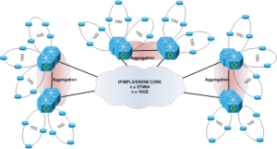
Reinventing the Access Network
Anastasios Chatzithomaoglou
(achatz@forthnet.gr)
IP Engineering – Forthnet
17-10-2013

Slide 2
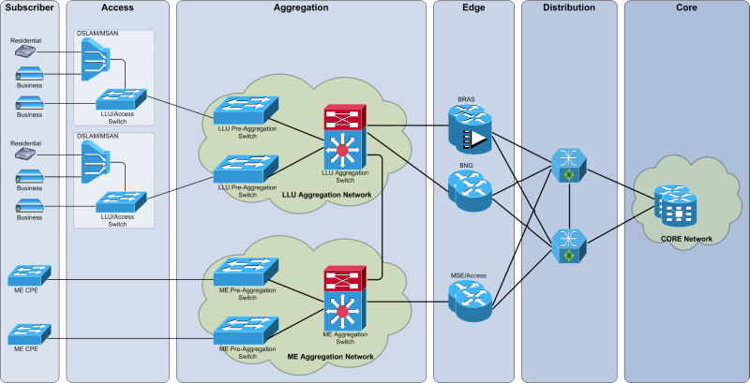
Reinventing the Access Network
High Level Design
This presentation focuses on this part of the network

Slide 3
Reinventing the Access Network
Terminology
The usual jargon
LE (Local Exchange )
The place where subscriber lines are terminated per geo-area
POP (Point of Presence)
The place where Aggregation & Edge Routers can be installed
Access Router
The L2/L3 device that connects all L2 access devices to the rest of the network
Aggregation Router
The L2/L3 device that connects multiple Access Routers to multiple Edge Routers
Multiple levels of aggregation can exist
Edge Router
The L3 device on the Edge Network that offers the final IP service to the subscriber (i.e. BRAS/BNG)

Slide 4
Reinventing the Access Network
Services
Business
L2 Services
EPL/EVPL
VPN/ELAN
NNI
L3 Services
Internet
Voice
VPN
NNI
Residential
L3 Services
Internet
Voice
Services
PPPoE
IPoE

Slide 5
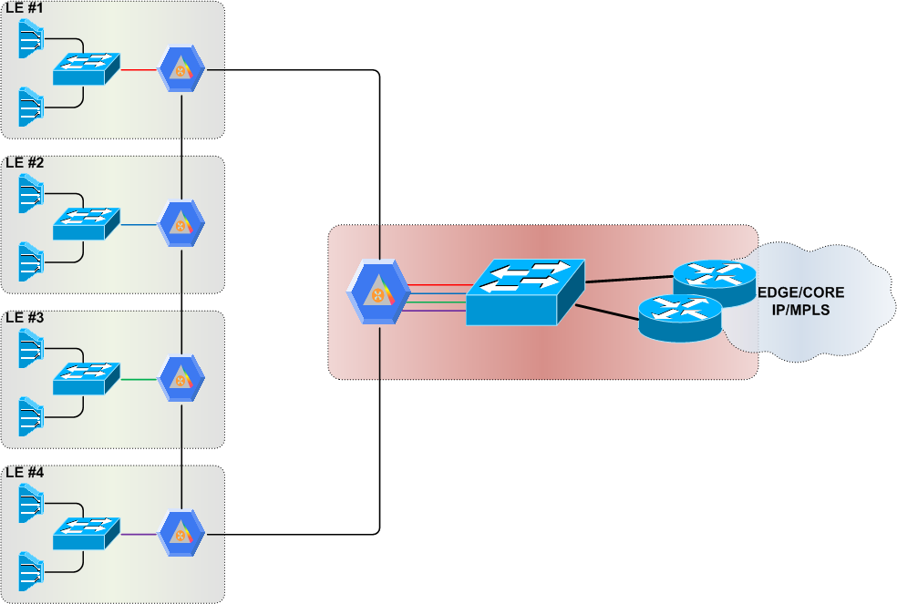
Reinventing the Access Network
Access Network in 2006
2,5G SDH Rings
600M PtoP EoSDH Circuits
600M
BRAS clustering using PADO priorities
600M
4x1G
2,5G
600M
600M
A typical part of the access/aggregation network

Slide 6
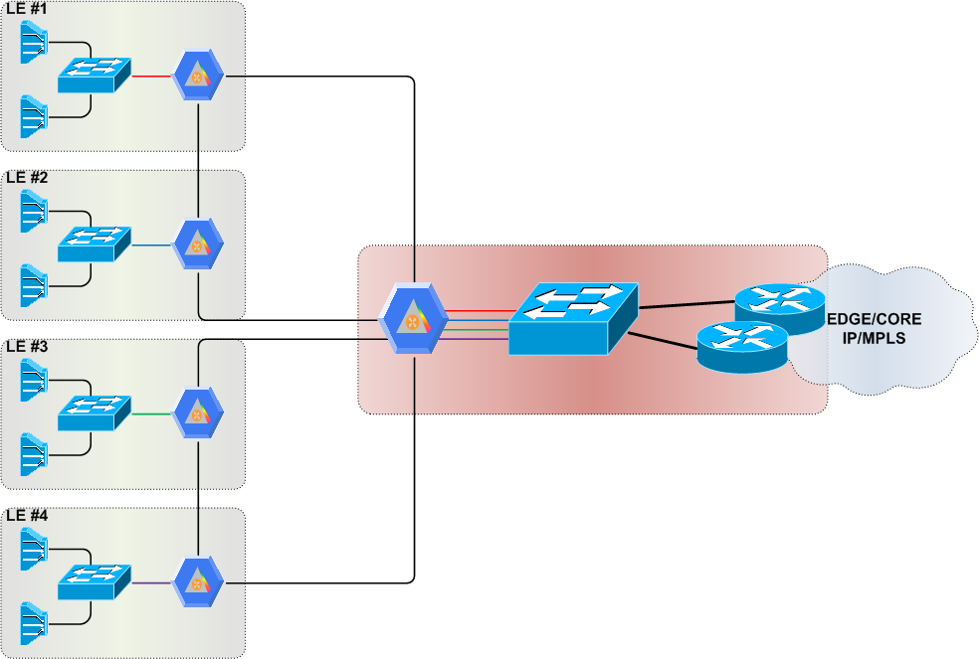
Reinventing the Access Network
Access Network in 2008
2,5G SDH Rings
1G PtoP EoSDH Circuits
1000M
2,5G
1000M
4x1G
1000M
2,5G
1000M

Slide 7
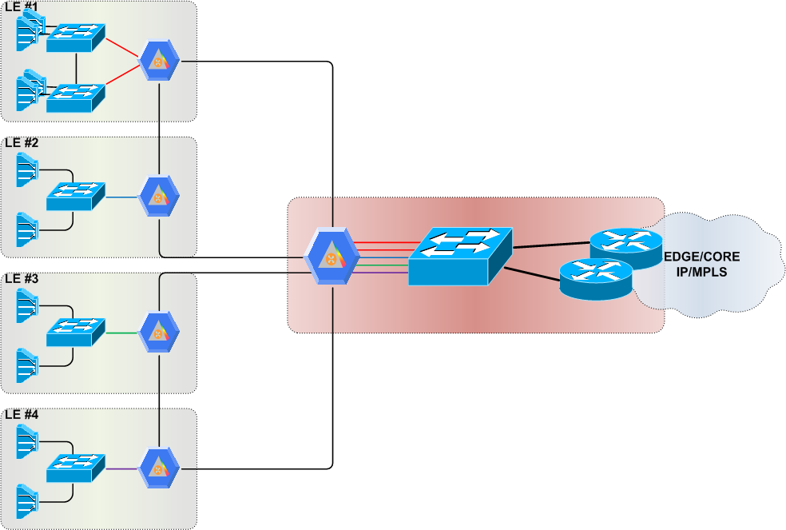
Reinventing the Access Network
Access Network in 2010
700M
2,5G SDH Rings
1,2G PtoP EoSDH Circuits
STP for Redundancy
500M
2,5G
1000M
5x1G
1000M
2,5G
1000M

Slide 8
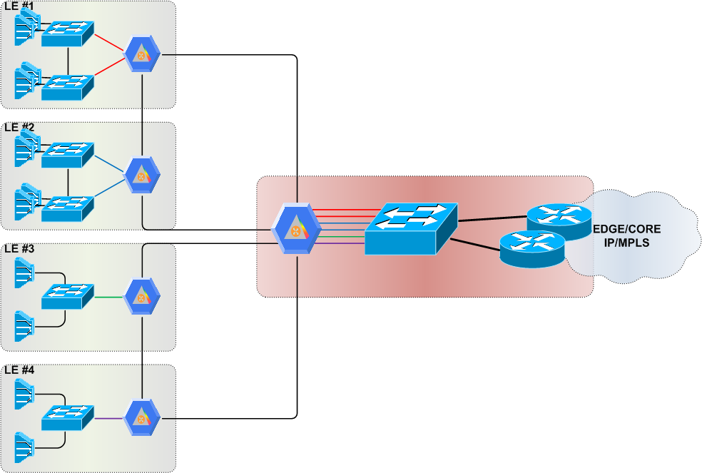
Reinventing the Access Network
Access Network in 2011
700M
2,5G SDH Rings
1,2G PtoP EoSDH Circuits
STP for Redundancy
500M
600M
2,5G
6x1G
600M
1000M
2,5G
1000M

Slide 9
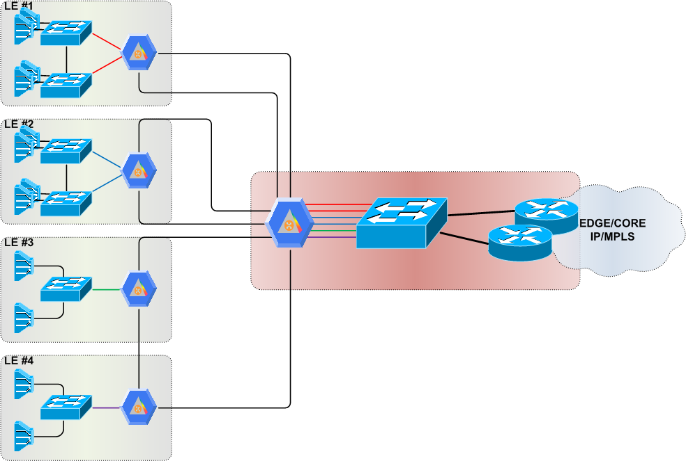
Reinventing the Access Network
Access Network in 2012
1000M
2,5G SDH Rings
2G PtoP EoSDH Circuits
STP for Redundancy
2,5G
1000M
1000M
2,5G
6x1G
1000M
1000M
2,5G
1000M

Slide 10
Reinventing the Access Network
Old Design
Issues with old design
Legacy SDH STM-16 transport
Large L2 domains (macs/broadcasts/loops)
Limited vlans (even with QinQ)
Max 2x1G capacity
Active/Standby Redundancy (based on STP)
Limited mac-address space

Slide 11
Reinventing the Access Network
Requirements of new Design
General Requirements of new Design
n x 10G only (40G/100G in the future)
L2CP transparency (especially for business services)
QoS bits transparency
Jumbo frames (> 9000 bytes)
Active/Active Redundancy whenever possible
No loss (< 50 ms) upon any Direct Link/Node failure
Minimal loss (< 1 sec) upon any Remote Link/Node failure
No need for very large scalability
As much formulation/standardization as possible

Slide 12
Reinventing the Access Network
L2 vs L3 & Transport
L2 HW Solutions L3 HW Solutions
Multiply 1G uplink of Access Switch
Install 10G Access Switch Install 10G Access Router
Transport Solutions
Upgrade SDH to STM-64
Replace SDH with WDM
Remove SDH
X
?
√
X
?
√

Slide 13
Reinventing the Access Network
Thinking about L2
G.8032v2
Too cumbersome
Extra vlans per LE
Limited public exposure
TRILL & SPB
Mostly focused on DC (not applicable for Carrier Ethernet)
Limited OAM functionality (under development)
Non-existent support by CE products
Vendor Proprietary Solutions
Might do the job quite well
Possible vendor lock-in
Prefer vendor agnostic solutions, unless no such solution exists
Final Decision
Move toward unified network architecture based on IP/MPLS
Expand L3 deployment from Core/Edge to Aggregation/Access

Slide 14
Reinventing the Access Network
Thinking about L3
IGP + optimizations
Simple and works in every case
Slow convergence (hello/timer tuning might fix it)
MPLS TE/FRR
Too complex (although used in other parts of the network for TE)
No easy way for automation (affinity/manual)
Explicit paths for inter-area tunnels
(r)LFA
Plug & Play (unless IETF blows it up)
Some topologies not covered 100%
Micro-loops are possible
BFD
Use to detect losses due to virtual ifs (otherwise it would be detected at PHY, due to FO)
SW-based in some platforms
EoMPLS/VPLS
A/A and A/S Pseudowires to transfer L2 services from Access to Aggregation
PW-HE
Remove completely Vlans/L2 from Aggregation
More Pseudowires from Access to Edge

Slide 15
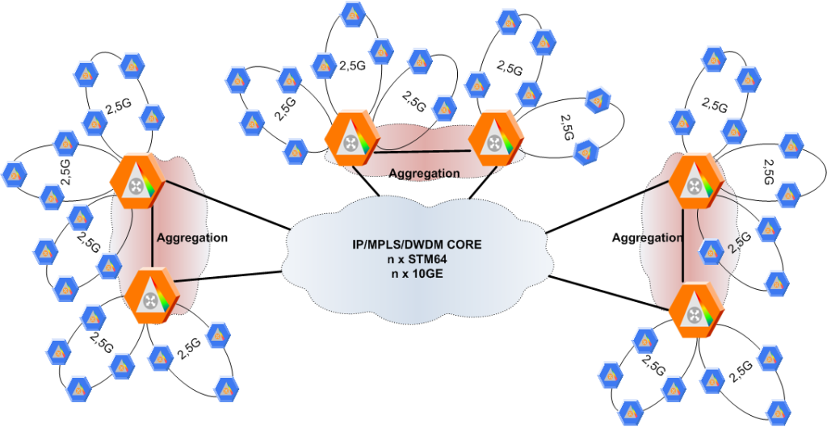
Reinventing the Access Network
Old design
From 2,5G SDH Rings

Slide 16
Reinventing the Access Network
New design
To 10G FO/IP Rings

Slide 17
Reinventing the Access Network
Old Design vs New Design
Old Design
Legacy SDH STM-16 transport
Large L2 domains
Limited vlans (even with QinQ)
Max 2x1G capacity
Redundancy based on SDH/STP
Limited mac-address space
New Design
Direct FO, no SDH
Limited L2 domains
Many PWs
Max 2x10G capacity
Redundancy based on IP
x10 mac-address space

Slide 18
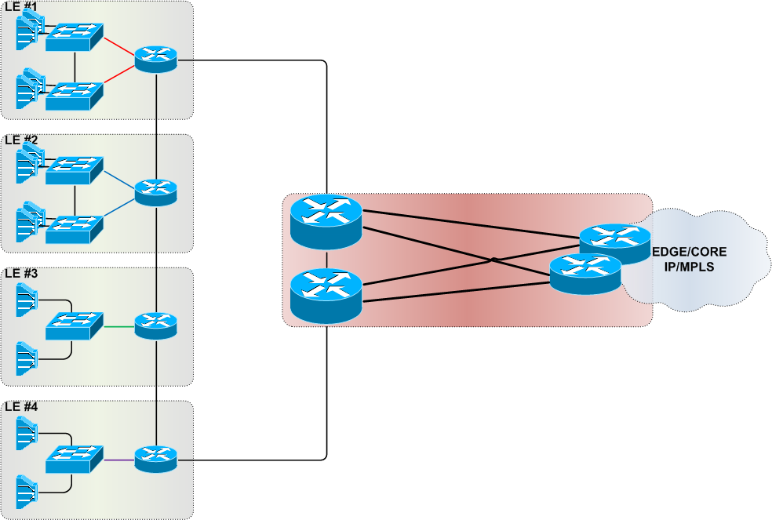
Reinventing the Access Network
Access Network in 2013
1000M
10G FO Rings
10G Circuits
IP/FRR for Redundancy
1000M
1000M
BRAS clustering using PADO priorities
nx10G
1000M
10G
1000M
1000M

Slide 19
Reinventing the Access Network
Low Level Design
Access Router
Aggregation
Router
Edge
Router
BD
VFI
VFI
BD
BRAS/BNG
BD
VFI
BD
EFP
EFP
EFP
BD
VFI
VFI
BD
BD
BRAS/BNG
VFI
BD
EFP
EFP
EFP

Slide 20
Reinventing the Access Network
IGP
IGP Details
IPv4 10.X.Y.Z addressing (no IPv6 for LDP yet)
OSPF (already used in the network)
Area 0 for aggregation
Area 0.X.Y.Z for all access rings between POPs X & Y
Multi-area adjacency (if needed for intra-area vs inter-area)
No external prefixes, no ASBRs
Every adjacency configured as point-to-point
BFD tx/rx 100 multiplier 3 (buggy)
LFA support only for Loopbacks (buggy)

Slide 21
Reinventing the Access Network
Pseudowires
PW Details
Numbering based on VLAN-NUMBER-SERVICE (i.e. 3456011100)
MTU > 9000
Control Word enabled (avoid 4/6 mac issue in LB)
Active/Standby if attached to EFP/BD
Active/Active if attached to VFI
Split-Horizon disabled if > 2 IPoE Access PWs from same LE and no Access BD

Slide 22
Reinventing the Access Network
Management
Access Router Management
Different Loopback for Management
Recursive Static Default Route pointing to an Aggregation Router
Double Default Route through IGP (with different metrics)
Global => VRF in Aggregation Router towards Management Network
OOB over old EoSDH when possible
Note: Mgmt VRF in Access Routers also under consideration

Slide 23
Reinventing the Access Network
Load-Balancing
Issue
PWs between Access and Aggregation transport large volumes of PPPoE traffic, especially in the downstream direction. Need to make sure that they are split over multiple links.
Solution
Improve granularity on the hashing of traffic running over PWs by introducing one or more additional labels
Intermediate nodes need only to make an ECMP choice based on a hash of the MPLS label stack
FAT-PW
Interface Parameter FL Sub-TLV in LDP
Directly between ingress & egress PEs
Entropy Labels
From egress LSR to ingress LSR
1 label (flow label)
2 labels (ELI, entropy label)
Mapping ELC TLV in LDP
Packet ordering must be preserved only within the context of each individual transported IP/Eth flow
The requirement to load-balance over multiple PSN paths occurs when the ratio between the access PW utilisation and the PSN's core link capacity is large (e.g., >= 1:10)
+ Internal Label Hack

Slide 24
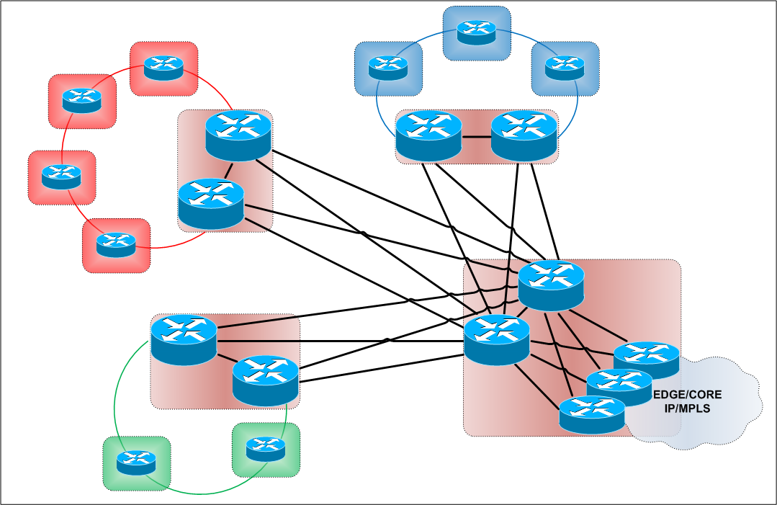
Reinventing the Access Network
Access Network in 2013 – Dual-Attached LEs
Dual-Attached LEs

Slide 25
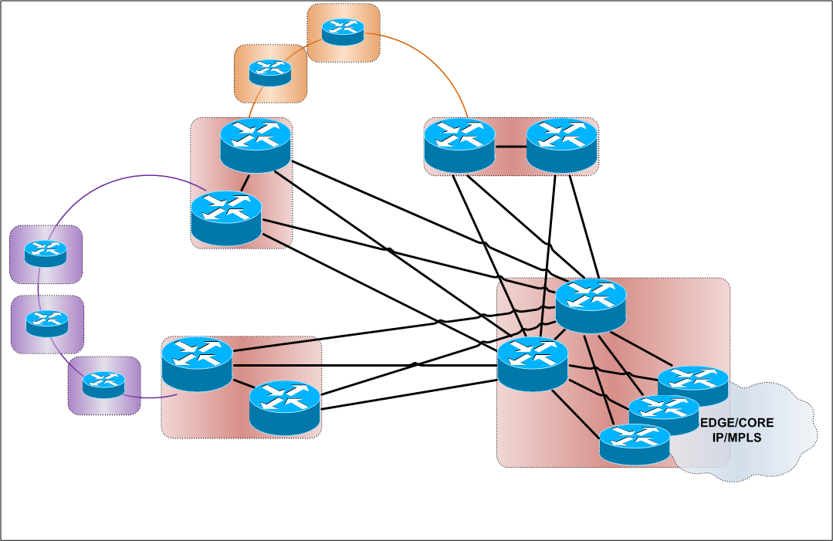
Reinventing the Access Network
Access Network in 2013 – Dual-Homed LEs
Dual-Homed LEs

Slide 26
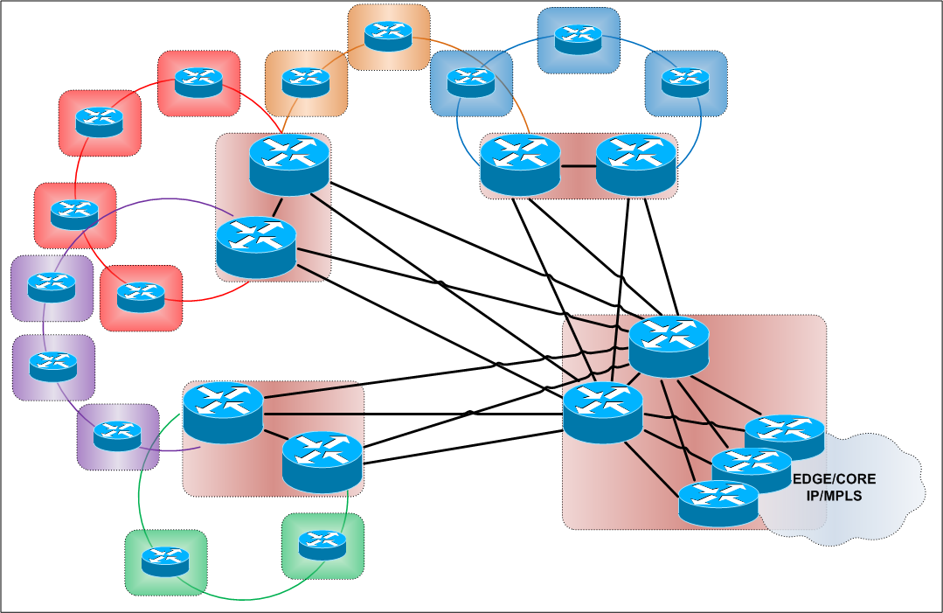
Reinventing the Access Network
Access Network in 2013 – Dual-Attached/Homed LEs
Dual-Attached LEs
Dual-Homed LEs

Slide 27
Reinventing the Access Network
Migration
Migration Steps
Move from aggregation towards access
Edge doesn’t need to be changed
New aggregation routers between old aggregation switches and edge routers
Extra PWs between old and new aggregation devices
Use parallel circuits to change from L2 to L3
Many maintenance windows, many bugs

Slide 28
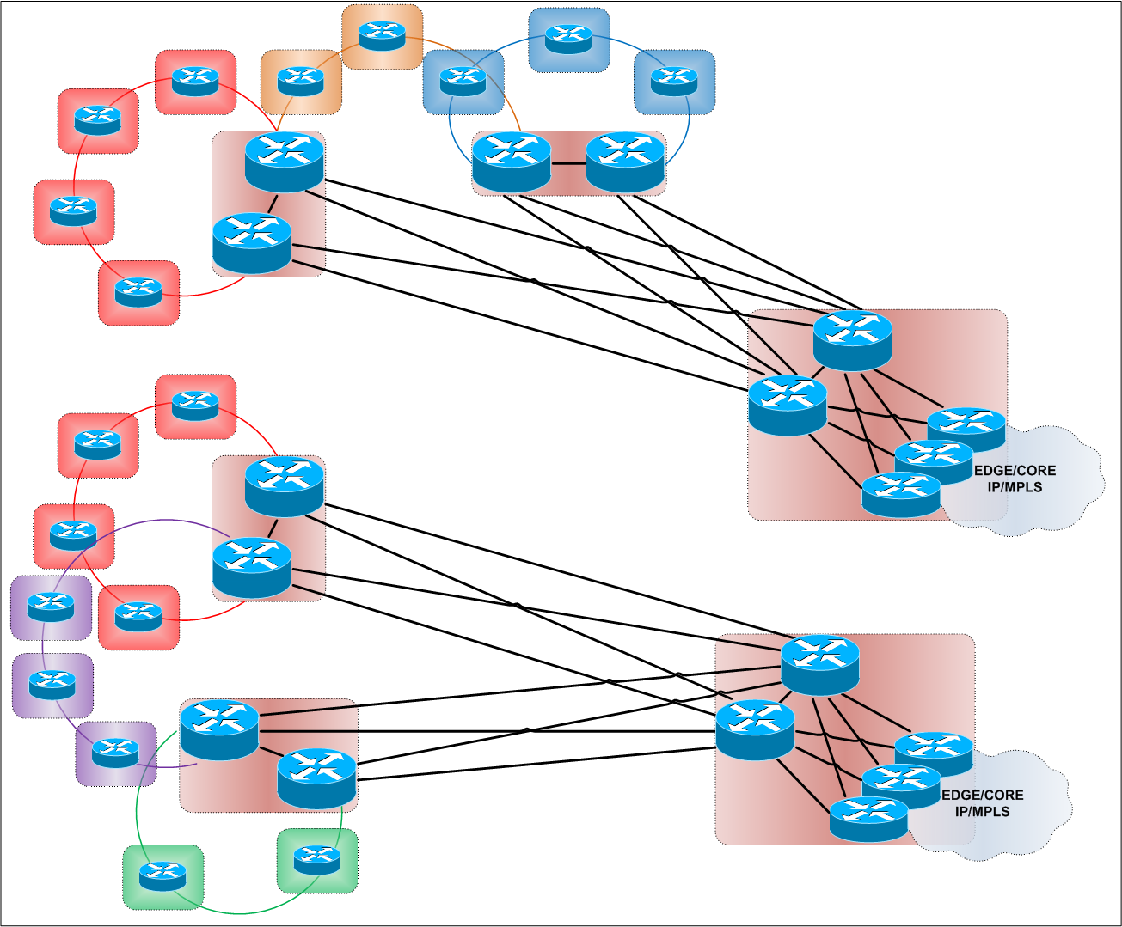
Reinventing the Access Network
Access Network in 2013 – Zoom Out
n Access LEs
n Aggregation POPs
1 Edge POPs per Aggr POP
Can we improve
flexibility &
redundancy
even more?

Slide 29
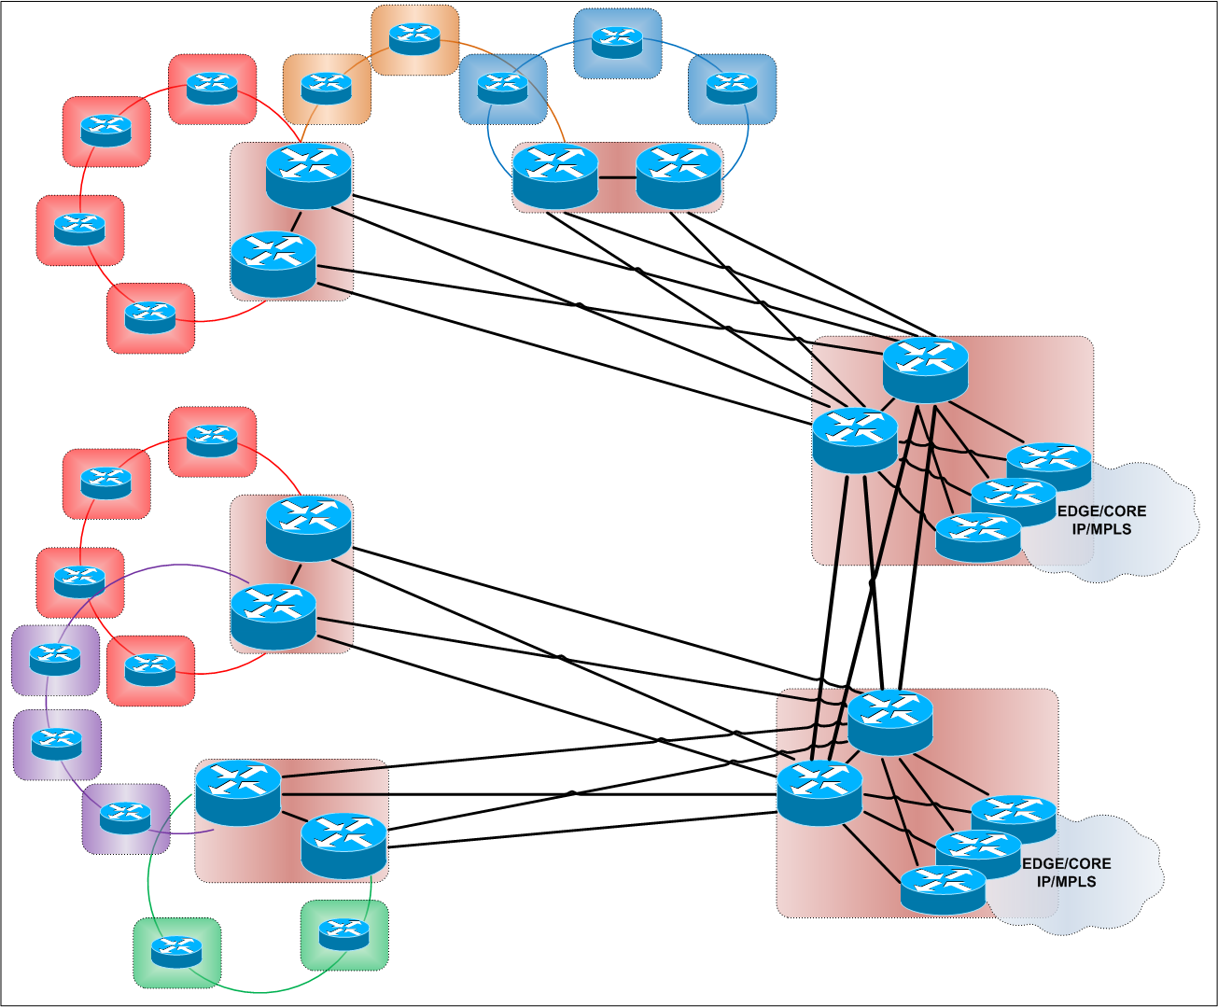
Reinventing the Access Network
Access Network in 2013 – Edge Cloud
n Access LEs
n Aggregation POPs
n Edge POPs per Aggr POP
BRAS clustering using PADO priorities
BRAS clustering using PADO priorities
Something is still missing…

Slide 30
Reinventing the Access Network
Poor Man’s SDN

Slide 31
Reinventing the Access Network
Things to check out
Future things to evaluate
Multicast efficiency (draft-ietf-l2vpn-vpls-mcast)
EVPN (draft-ietf-l2vpn-evpn)
Labels in BGP (RFC 3107)
VPLS Auto-discovery/Signaling with BGP (RFC 4761)
TDM services (with or w/o MPLS-TP)
Segment Routing (draft-filsfils-rtgwg-segment-routing)
Enhanced ECMP and Large FAT (draft-yong-pwe3-enhance-ecmp-lfat)
MRT-FRR (draft-ietf-rtgwg-mrt-frr-architecture)

Slide 32
Reinventing the Access Network
The End
Thank you!
Q & A

